Slide 1
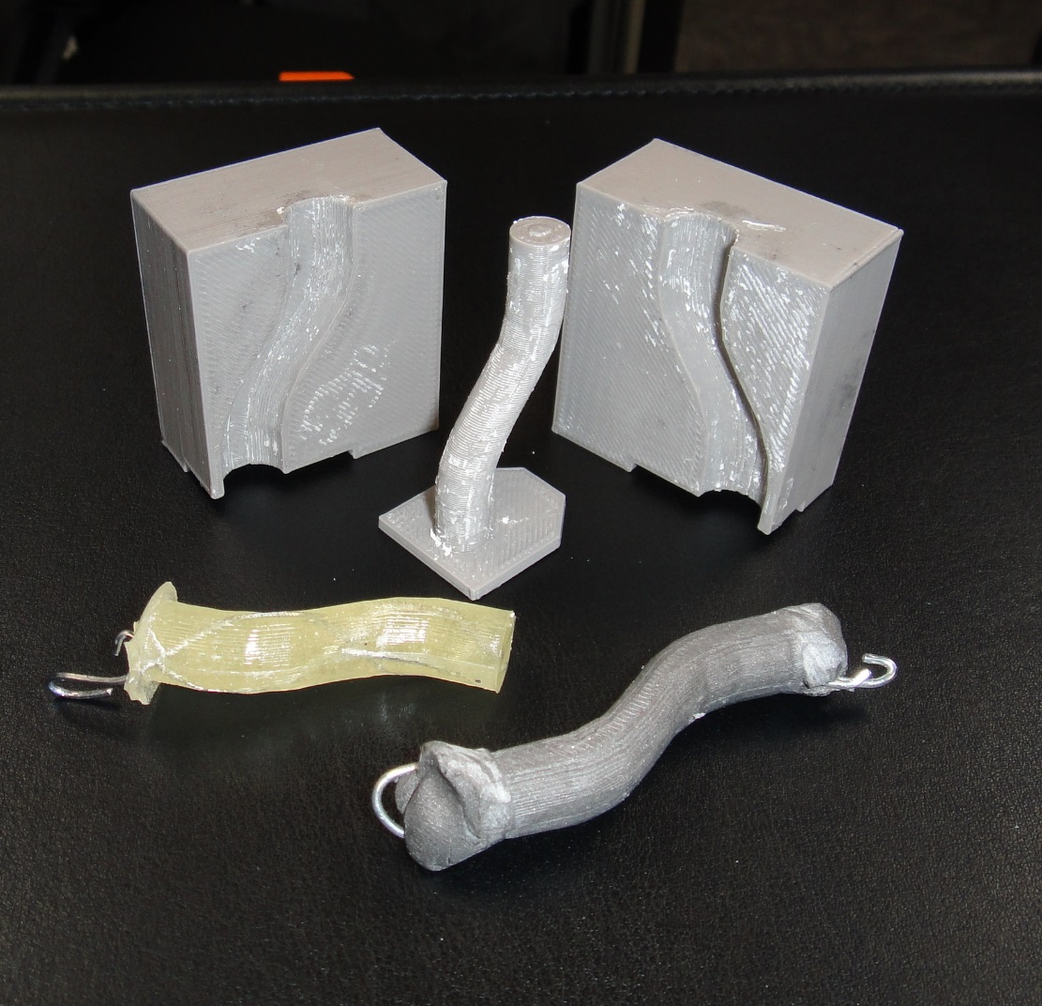
3-D molds in space
Demonstrate how a 3-D printer could be used for making molds so that replacement parts could be made with materials already on the space station.

Slide 2
Making gaskets
Gaskets and O-rings are something NASA would like to be able to make on orbit since these are things that wear out or rip during maintenance activities. Usually NASA keeps replacement parts on orbit but on the way to Mars this might not always work out.
This is the foaming RTV. It makes for a very flexible gasket material but is difficult to work with due to the mixing process. The ones I assisted with had voids due to the bubbles from the chemical reaction.
You can get it cheaply on e-bay. It is much more expensive if I have to buy it as I am required to purchase from an official vendor.
These are some O-rings students made as demonstrations for NASA in the fall of 2015.

Slide 3
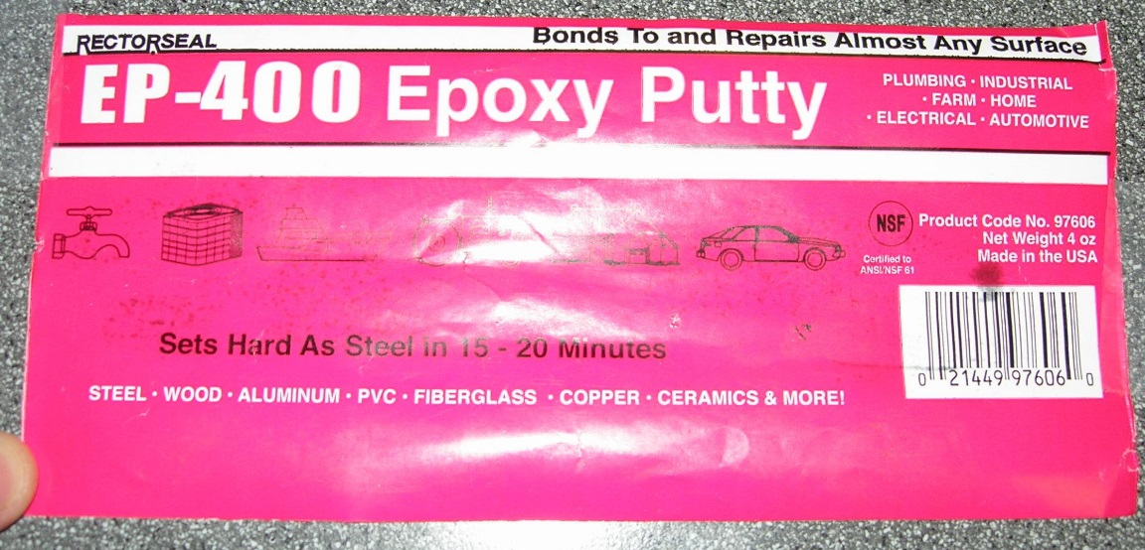
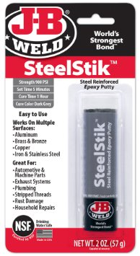
Epoxy
This is the type of epoxy putty that is currently on the station. This isn’t expensive but I don’t see it in as many stores.
This is a similar type of epoxy that seems to be easier to find for testing and still seems to have similar properties.

Slide 4
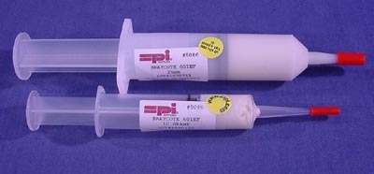
Braycote as a releasing agent
Once you have a mold and a material for putting into the mold, you must also have a way of releasing the hardened object from the mold. Something that will prevent sticking.
Braycote is a silicone and Teflon based lubricant that is used on the space station for a large variety of purposes. If we are able to convince NASA of the viability of molding objects in orbit, this is probably the releasing agent they will use. A very small amount goes a very long way. Unfortunately it is also about $600 for a small tube of it.
I’ve been using white lithium grease as a releasing agent for this type of applications and it seems to have similar properties at the temperatures and conditions of this activity. Again, a little goes a long way. No particular name brand is important. This is a lot cheaper than Braycote.
Type of Braycote used on the ISS
An inexpensive alternative to using Braycote as a releasing agent.

Slide 5
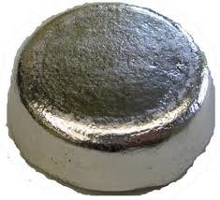
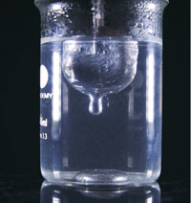
Field’s metal is a low melting temperature alloy. It will melt at 144 F which is within the range of the food preparation equipment on the station and does not contain lead so it is possible that it could be certified for the ISS. Unfortunately it is also about $90 per pound. Woods metal is also a low temperature metal but it contains lead so it probably couldn’t be sent to the station but it maybe similar enough and cheap enough that we could do demonstrations with it.
Alloy | Melting point | Eutectic? | Bismuth | Lead | Tin | Indium | Cadmium | Thallium | Gallium | Antimony
Rose's metal | 98 °C (208 °F) | no | 50% | 25% | 25% | – | – | – | – | –
Cerrosafe | 74 °C (165 °F) | no | 42.5% | 37.7% | 11.3% | – | 8.5% | – | – | –
Wood's metal | 70 °C (158 °F) | yes | 50% | 26.7% | 13.3% | – | 10% | – | – | –
Field's metal | 62 °C (144 °F) | yes | 32.5% | – | 16.5% | 51% | – | – | – | –
Cerrolow 136 | 58 °C (136 °F) | yes | 49% | 18% | 12% | 21% | – | – | – | –
Cerrolow 117 | 47.2 °C (117 °F) | yes | 44.7% | 22.6% | 8.3% | 19.1% | 5.3% | – | – | –
Bi-Pb-Sn-Cd-In-Tl | 41.5 °C (107 °F) | yes | 40.3% | 22.2% | 10.7% | 17.7% | 8.1% | 1.1% | – | –
Galinstan | −19 °C (−2 °F) | yes | <1.5% | – | 9.5-10.5% | 21-22% | – | – | 68-69% | <1.5%

Slide 6
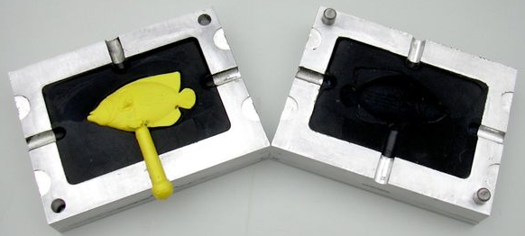
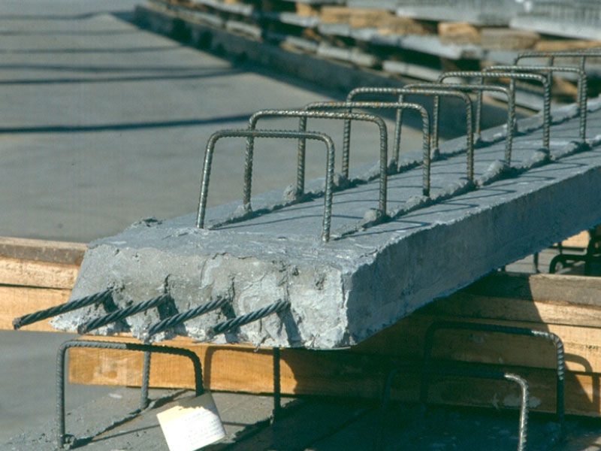
Methods of making molded materials
There are several different methods for molding objects and also methods for making the objects stronger.
Material could be injected into a mold and then the unwanted part could be cut off. Bubbles act different in zero-g so make sure you have some kind of exit port for the air coming out of the mold.
Concrete is poured into a form with rebar. Once hard, the concrete is stronger because of the reinforcement of the internal steel frame. This could be done to tools made from epoxy with wire or even using the plastic of the mold itself.
Material could be poured or pressed between the mold until cured or cooled to obtain the correct shape. Pouring would be difficult in zero-g.

Slide 7
ISS Food Warmer and Field’s metal
The ISS Food Warmer is an aluminum brief case with an electric hot plate in the middle of some insulating foam. MRE’s and other food packets are placed inside and pressed against the hot plate. The hot plate gets up to about 180F. There are timing lights on the side so the crew can judge how long the food has been warming. This is the most likely method of melting the Field’s metal on the station.
If we were to put some Field’s metal into a modified drink pouch and place it in the food warmer, the metal would melt and it could be squeezed like tooth paste into what ever mold you designed.
What kind of connector could you make to go from a modified drink pouch to your mold?
Does the connector need a valve to keep the liquid metal from floating out at the wrong time?
How will you keep the metal from solidifying and clogging up the entry port on the mold? Can clogging be prevented with a larger or smaller hole?

Slide 8
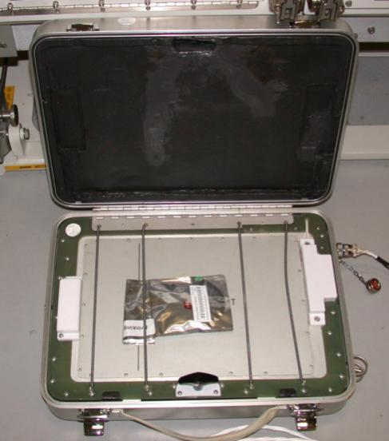
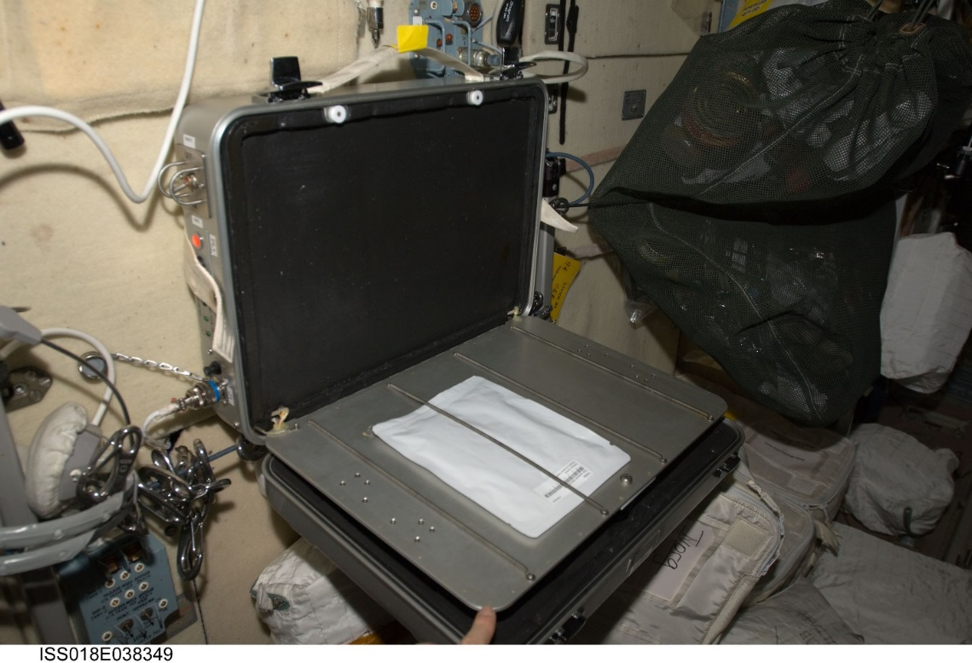
Food Warmer Pictures
Food Warmer on obit with tortilla pouch warming up.
Trainer Food Warmer with drink pouch warming up.

