Slide 1
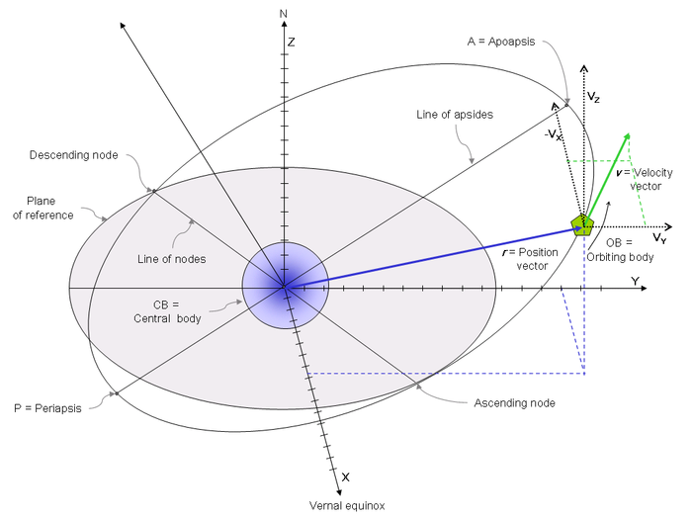
ISS Location APP
Problem:
When astronauts are on the phone with their friends, family, or students across the world, they are commonly asked where on Earth they’re currently flying over. Without looking out of the Cupola, they have no way of knowing what country/continent they are over. In order to counteract this, they want an app for their tablets able to work on both an IOS and Windows operating system that will be able to display the country they are flying over as well as a basic visual of what the country looks like from an aerial view.

Slide 2
Constraints
Needs to be able to work on both an IOS and Windows operating system.
Needs to be able to receive a State Vector or Two Line Element (which contains location data), from a Station Support Computer (SSC) server and process the information into coordinates.
Must be able to pull a state vector from the server as well as receive a manual state vector for testing.
Needs to have an aerial view of a country included with the name of a country (cannot be just a blank screen with writing). This is the feature that will make it most appealing.
Able to report the local time of the ground below as they fly over.
Will connect to the server through a TCP/IP connection to receive a SV.

Slide 3
The Programming Language
There will not be a requirement for a specific programming language for the app to be written in, as long as it can work on both an IOS and Windows operating system.
As long as your code itself is correct regardless of what language it is written in, the option to write in a translator into a different language is always available. This way, should your preferred language not be compatible with an IOS operating system, you can make it compatible.
Should your app be programmed in a language compatible with both an IOS and Windows operating system, there will be no need to install a translator.

Slide 4
The Connection to Station
The app itself will connect to a Station Support Computer (SSC) via a standard TCP/IP connection. From the SSC, we will be able to retrieve the data for the location of the station in either a State Vector format (SV), or as a Two Line Element (TLE). Your program will be able to work in either format, but it will be up to you to choose which form you want to request the data in. There is no preference in form used.
In order to request the information it needs from the SSC server, it will send a simple XML request to the Time-Vector Server on the SSC asking for the latest orbital data.

Slide 5
SSC Connection Example
1) The application connects to the “Time-Vector Server” within the SSC via a TCP/IP socket
2) The application sends an XML request to the “Time-Vector Server” asking for the latest ISS orbital data
<GetPosition CatNum="25544" ReqFormat="tpf_Cartesian"/>
(‘25544’ is the USSPACECOM identifier for the ISS – ‘Cartesian’ is the state vector format being requested)
3) The “Time-Vector Server” responds with the state vector components the application will need to figure out where the ISS is/was at that time (as shown below).
<GetPosition Code="0" >
<TTVAPosition
CatNum="25544"
DataSource="tus_Uplink"
Format="tpf_Cartesian"
LastUpdateJD="2457968.38230619"
LastUpdateTime="2017/214/21:10:31.27" >
<TStateVectorEx
epochjd="2457968.07298611"
epochstr="2017/214/13:45:06"
frame="rf_M50"
orbitnumber="41784"
x="1533431.0500000000470000"
xdot="-7311.2845200000001570"
y="3941286.9700000002050000"
ydot="2212.7750700000001420"
z="-5313663.4400000004100000"
zdot="-469.7265699999999810" />
</TTVAPosition >
</GetPosition >
The state vector time tag and XYZ position and velocity components are found in the ‘TStateVectorEx’ element.
(Side note that the requested format can also be a Two-Line Element set if desired.)

Slide 6
Manual Input of a SV or TLE
The connection to the SSC will be critical to the success of your project, however, without a SSC here on the ground, we will be unable to test the app should there not be a manual way to input either a SV or TLE. Thus we must have a way to manually input a SV or TLE in order to test the app appropriately.
The manual input for the app should be able to be entered in either a TLE or SV format, depending on which form you request the information in from the SSC.

Slide 7
Examples of TLE and SV Formats
TLE Format
Below was the State Vector for the ISS at 16:05:32 on October 4, 2017
1 25544U 98067A 04366.97178262 .00025660 00000-0 19490-3 0 4889
2 25544 51.6395 35.9552 0003614 149.9145 282.2606 15.72139126349398
See the below resources for help understanding the components of a TLE
http://www.celestrak.com/columns/v04n03/
https://en.wikipedia.org/wiki/Two-line_element_set
SV Format
Below was the SV for the ISS at 16:11:27 on October 4, 2017
See the below resources for more help understanding the components of a SV
https://en.wikipedia.org/wiki/Orbital_state_vectors
https://spaceflight.nasa.gov/realdata/elements/index.html
https://spaceflight.nasa.gov/realdata/sightings/SSapplications/Post/JavaSSOP/orbit/ISS/SVPOST.html
TDR Cartesian
-----------------------------------
X = -8829502.78
Y = 10709598.14 feet
Z = 17372248.25
XDOT = -19821.286397
YDOT = -13709.437290 feet/sec
ZDOT = -1605.885144

Slide 8
Basic Functions of the App
As for the interface of the app, we want it to function as follows:
1. When the app is opened up, it will immediately connect to the SSC and pull the most relevant SV or TLE.
2. Once it has the information, it will then display a rough image of the Country the ISS is currently over, the name of the country, and the local time.
It is important that the app functions as such so it is easy to use for the crew on orbit. It does not need to pull this information continuously, just once as the app is opened up. However, it would be a challenge, and something HUNCH would be interested in having, if y'all were able to figure out how to have the app pull the SV or TLE continuously from the SSC and show the ISS moving across the screen.

Slide 9
Research Points
Research into SV and TLE formats to better determine the format you want for your project.
Research into the different time zones of the world as well as brushing up on your geography.
Research into what language you want to use to program the app (Remember: If the language you select is not compatible with an IOS operating system, you can always write in a translator into a language that is).
Research into USSPACECOM Identifiers

Slide 10
Additional Resources
https://worldview.earthdata.nasa.gov/
https://beebotte.com/tutorials/iss_realtime_position

